Slide 1
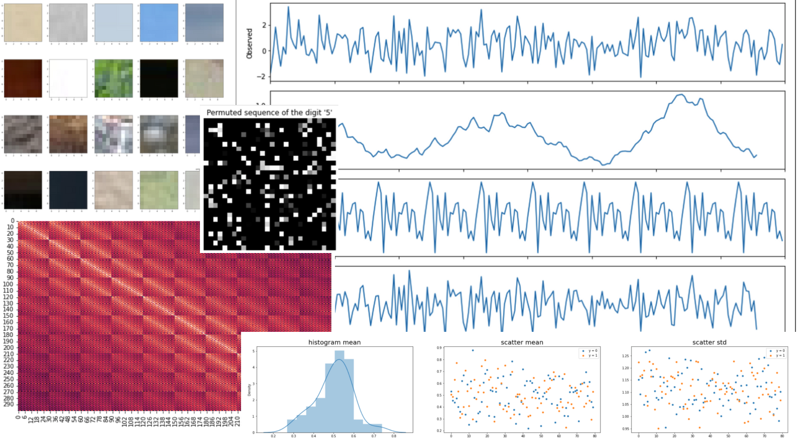

AIN6020
What am I looking at ?
Team 4 : Jinsoo Kim, Sunghyun Hwang, Myeongsoo Han,
Byeongtae Park, Eunseon Seong, Harim Lee

Slide 2
Dataset 1
Exploration Data Analysis
Modeling
Result
Appendix

Slide 3
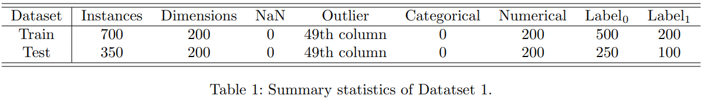
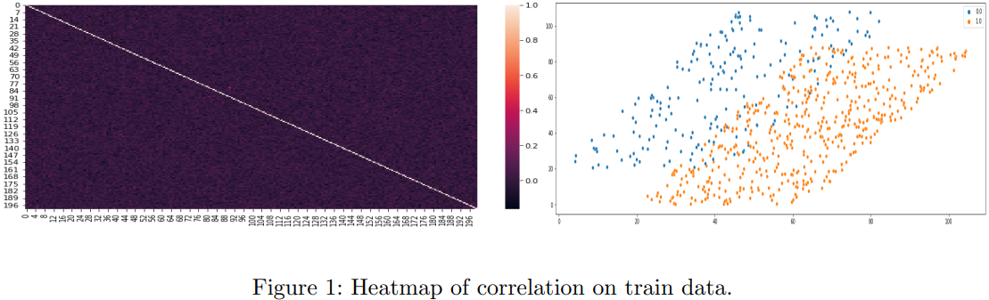
01
Exploration Data Analysis
3

Slide 4
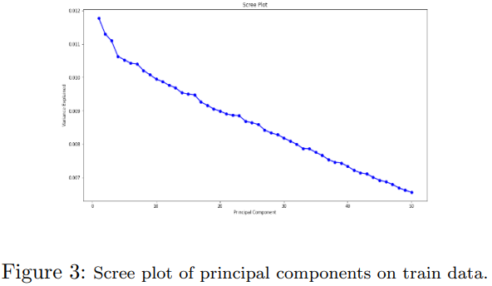
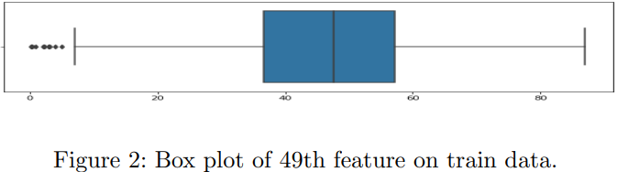
01
Exploration Data Analysis
4

Slide 5
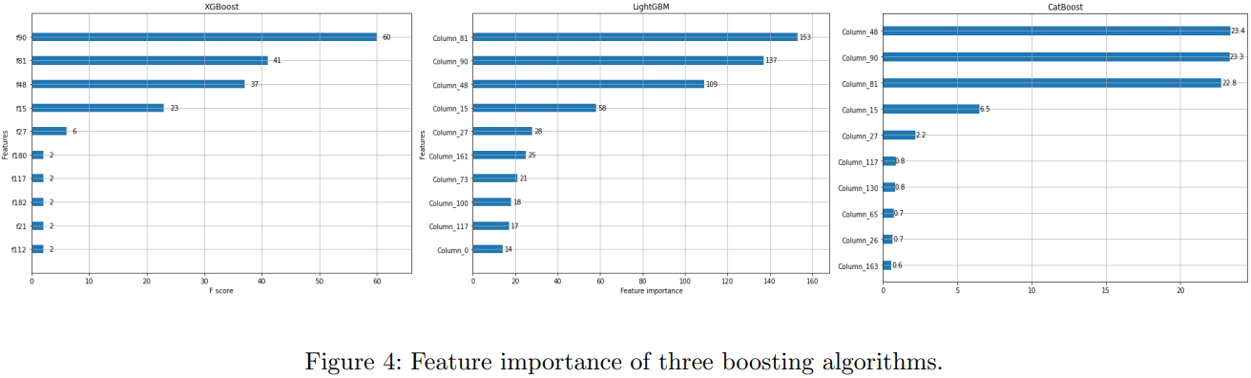
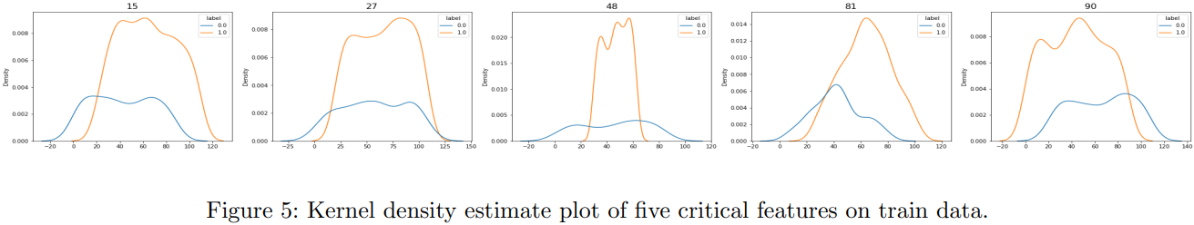
02
Modeling
5

Slide 6
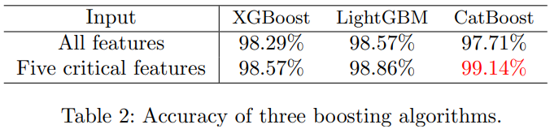
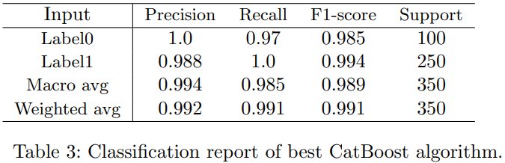
03
Result
6

Slide 7
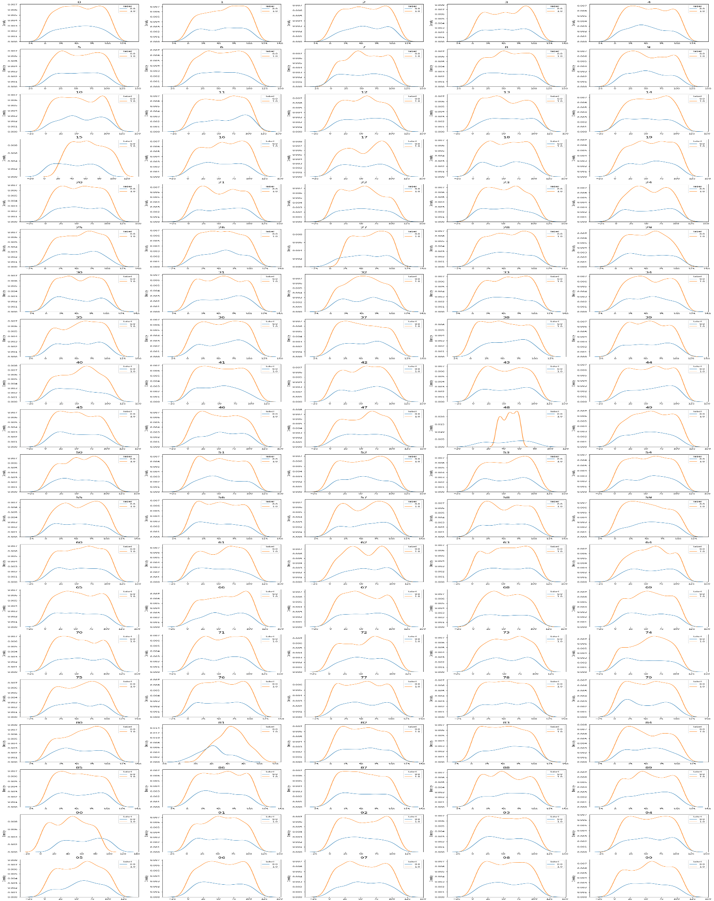
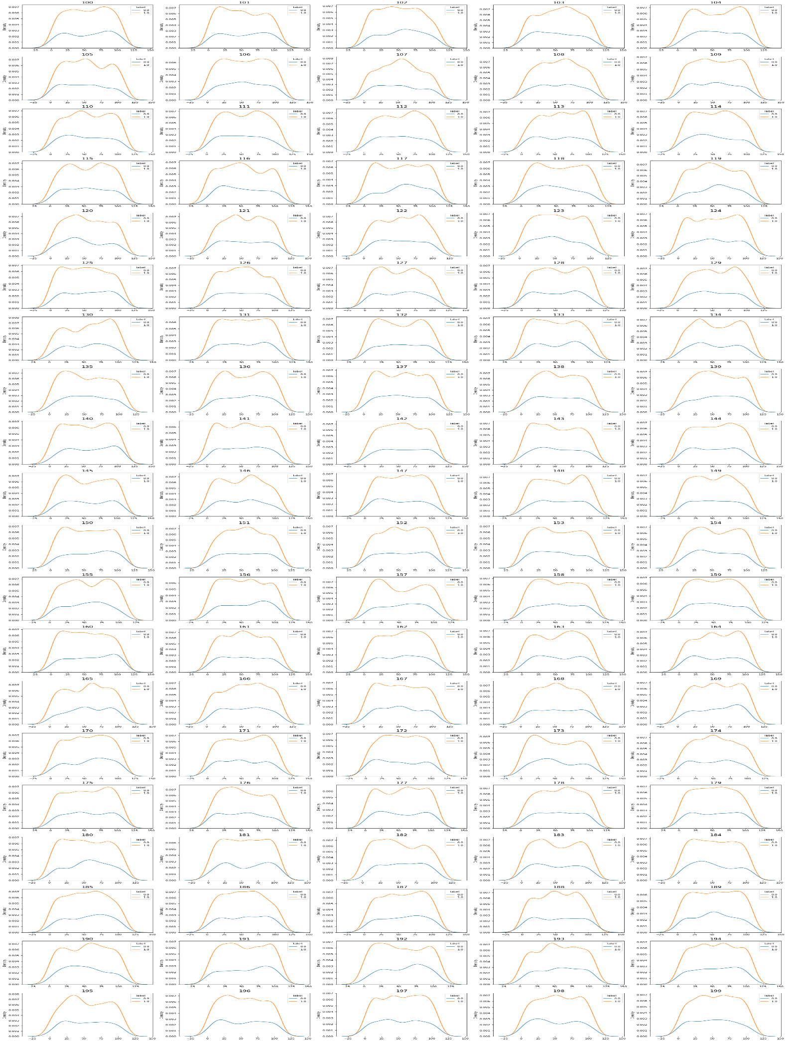
04
Appendix
7

Slide 8
Dataset 2

Slide 9
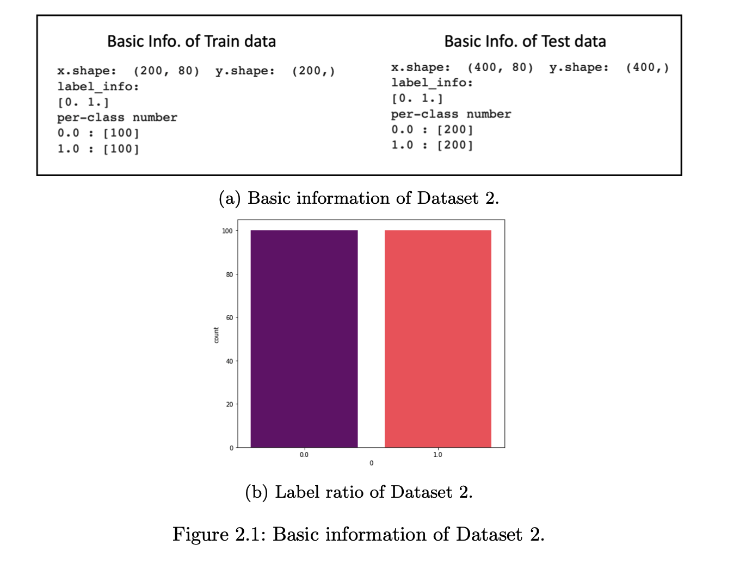
Data Description
Binary classification with balanced label
9

Slide 10
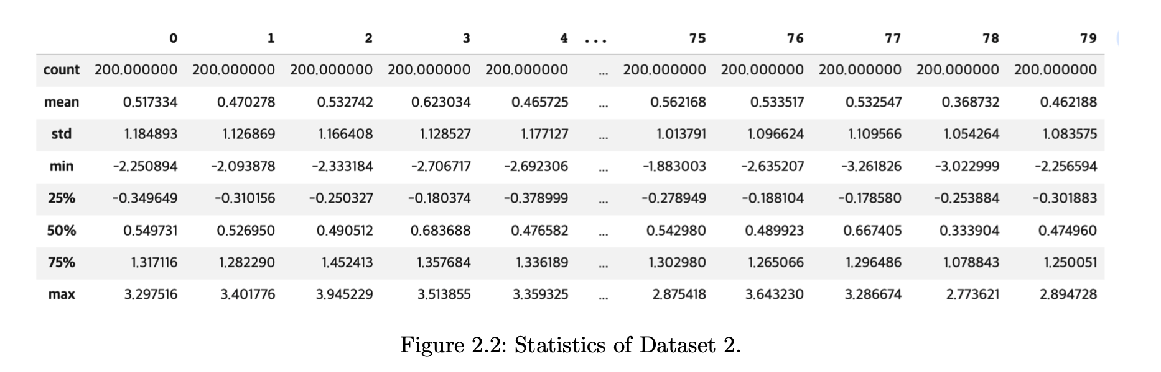
Data Description
Statistics
10

Slide 11
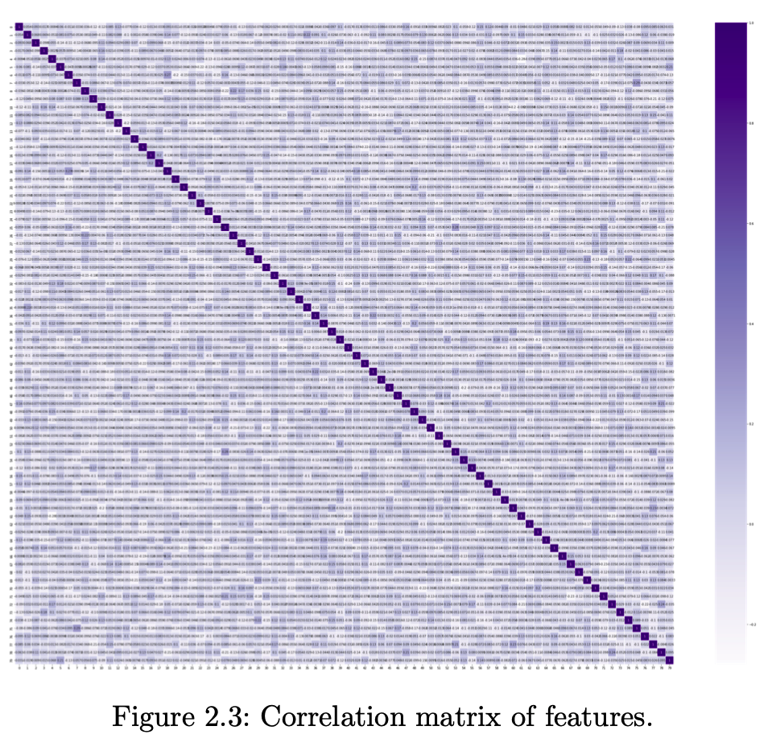
Exploration Data Analysis
Correlation Plot
There are not any special correlations
between features
11

Slide 12
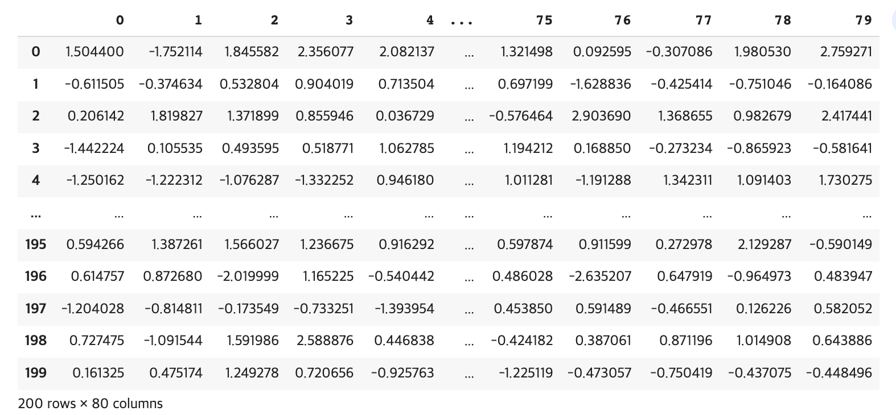
Exploration Data Analysis
Time Series Decomposition
80 features
It may be Tabular Timeseries Data!
200 time-stamp
12

Slide 13
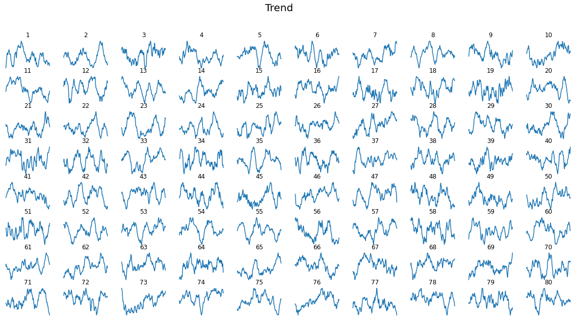
Exploration Data Analysis
Time Series Decomposition - Trend, Seasonal, Residual
13

Slide 14
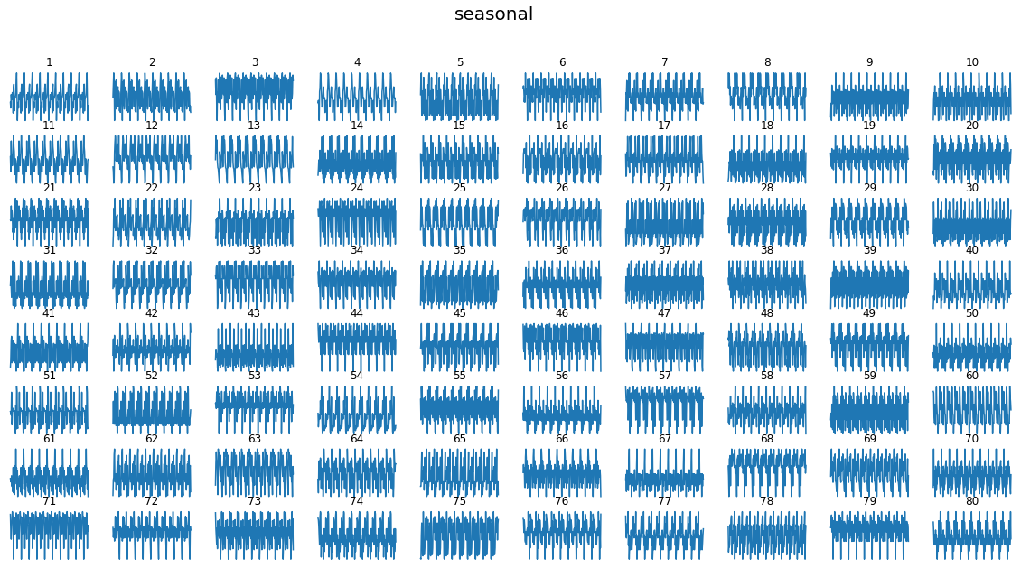
Exploration Data Analysis
Time Series Decomposition - Trend, Seasonal, Residual
14

Slide 15
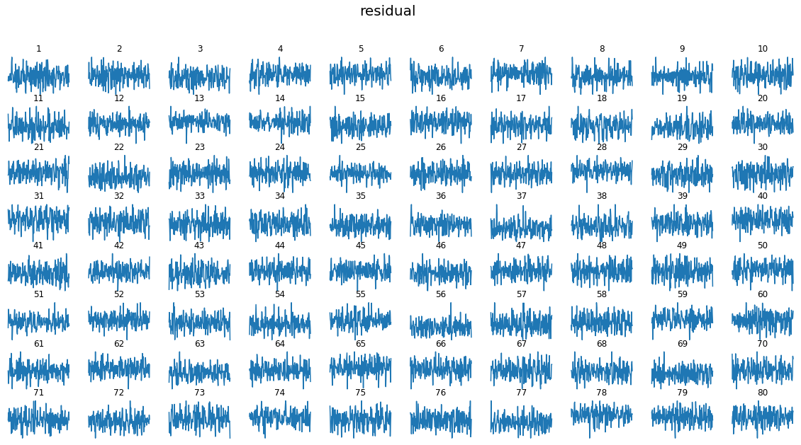
Exploration Data Analysis
Time Series Decomposition - Trend, Seasonal, Residual
15

Slide 16
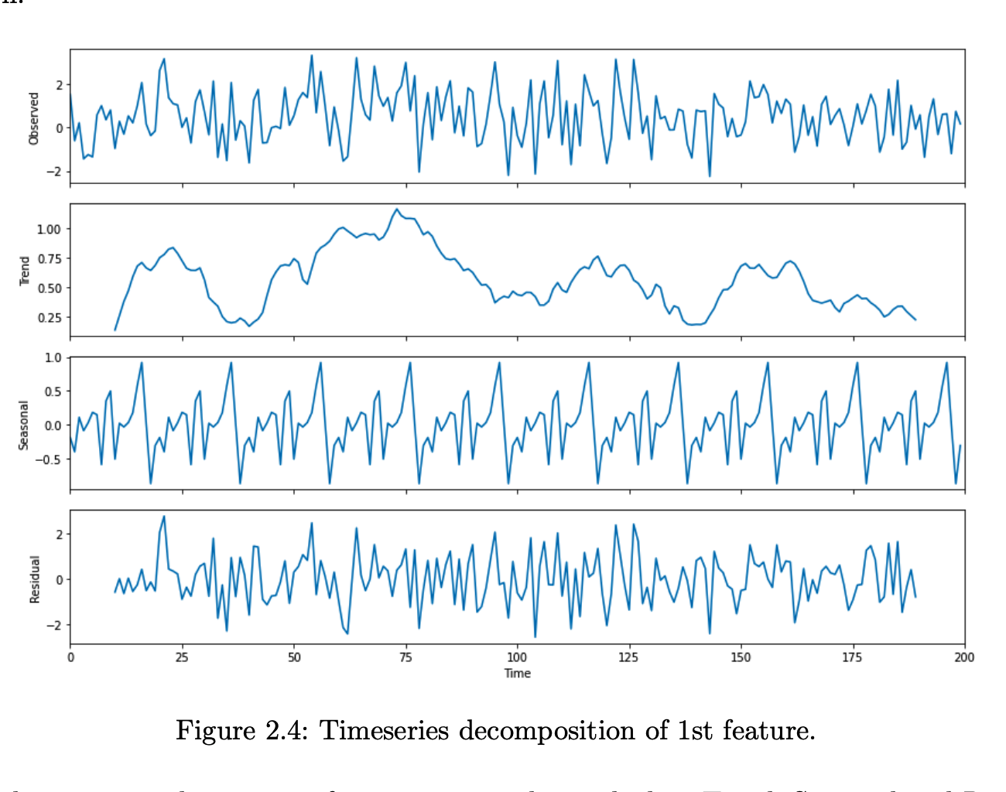
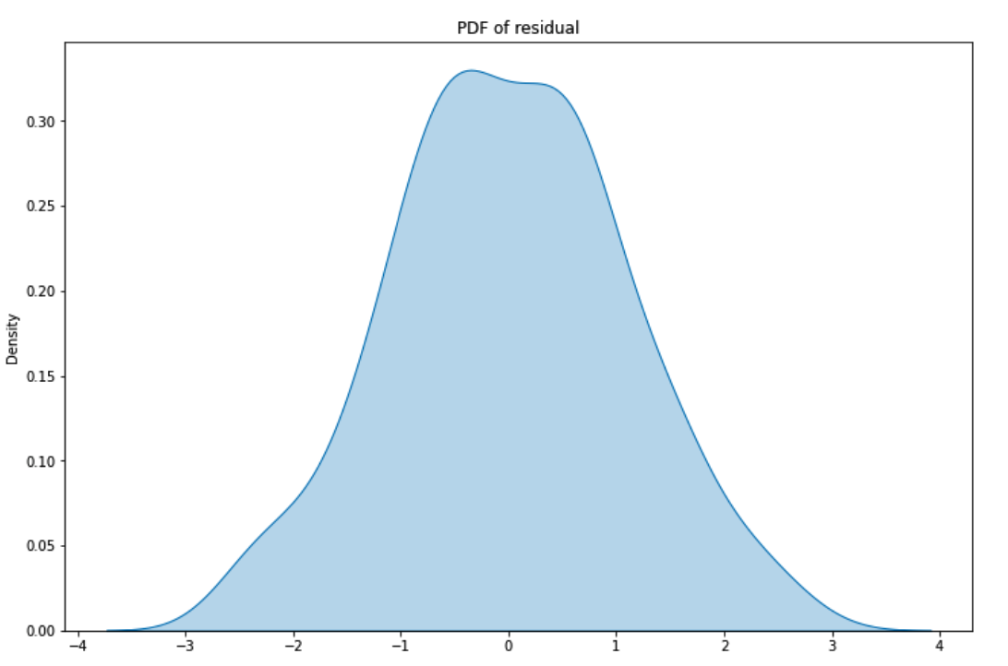
Exploration Data Analysis
Time Series Decomposition on 1st feature
PDF of Residual
gaussian / no special outliers
16

Slide 17
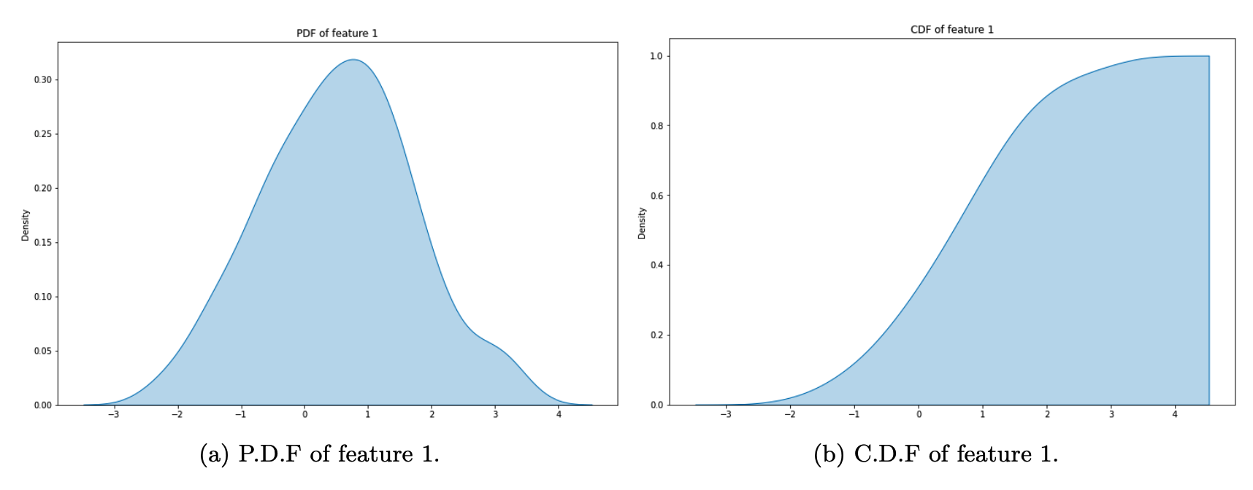
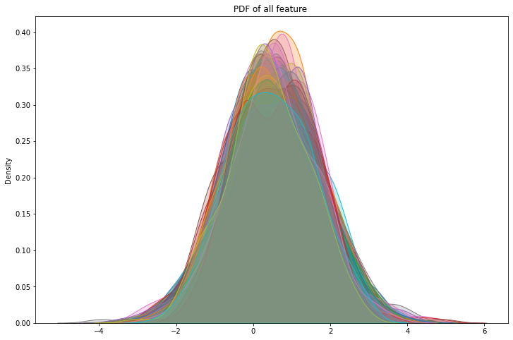
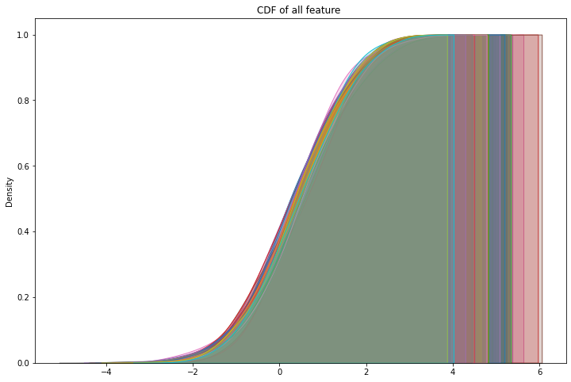
Exploration Data Analysis
PDF & CDF of all 80 features; Arbitrary Gaussian?
Feature 1
17

Slide 18
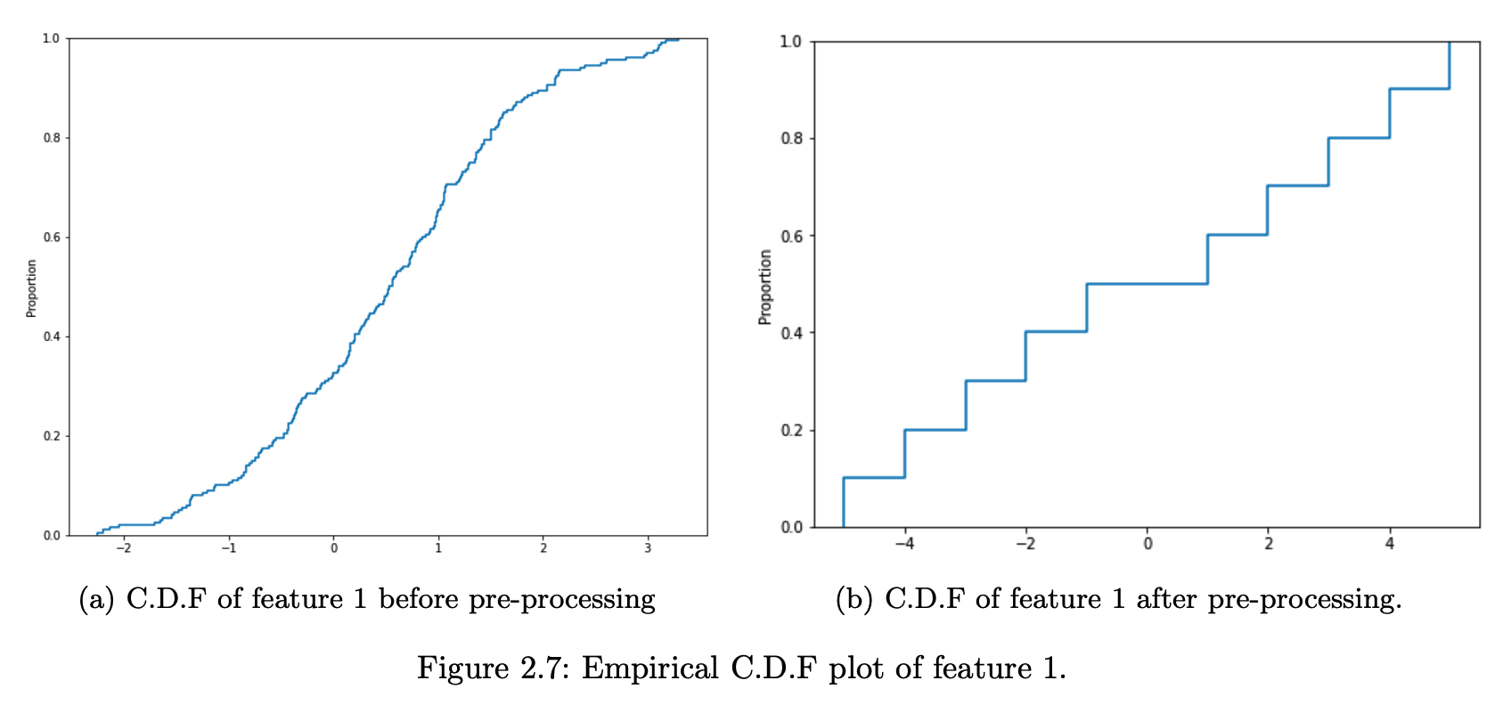
Preprocessing
Feature Quantization & Rescaling
10%
18

Slide 19
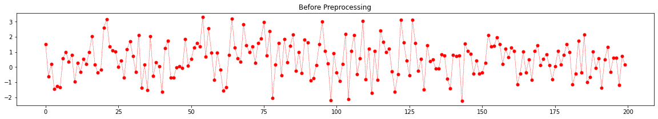
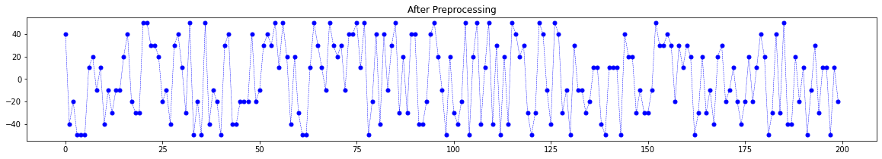
Preprocessing
Feature Quantization & Rescaling
19

Slide 20
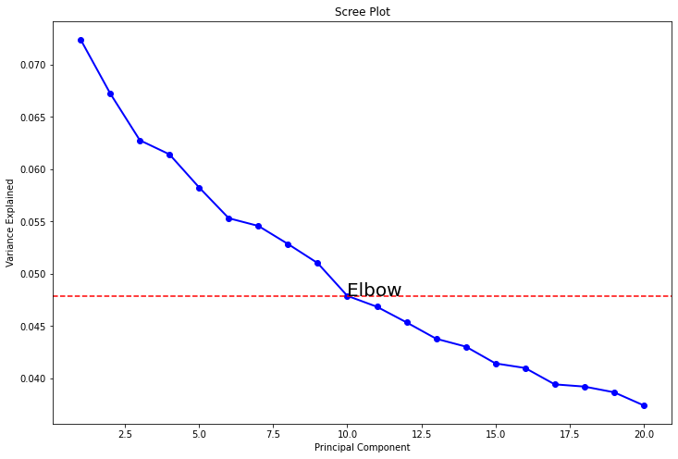
Modeling
Principle Component Analysis
Model input
10 PCs
+
preprocessed data
Kernel SVM with
polynomial kernel
20

Slide 21
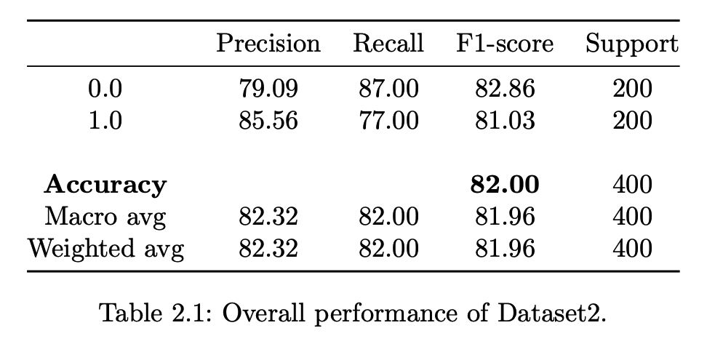
Result
Achieve 82.0% accuracy with test data
Follow parameters of NuSVC gives the best performance :
{nu = 0.64,
gamma = 'scale’,
coef0 = 0.075,
kernel = 'poly’,
degree = 3}.
21

Slide 22
Dataset 3

Slide 23
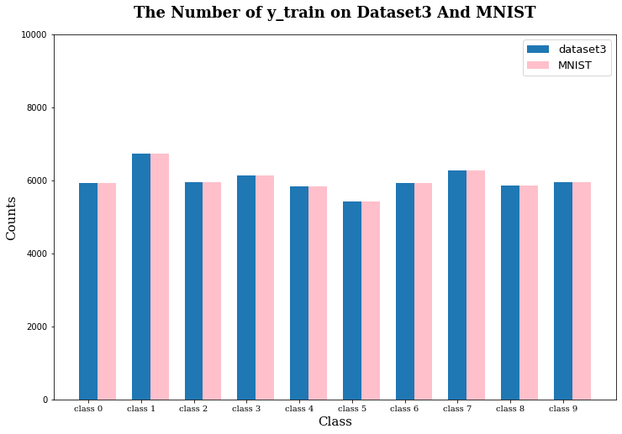
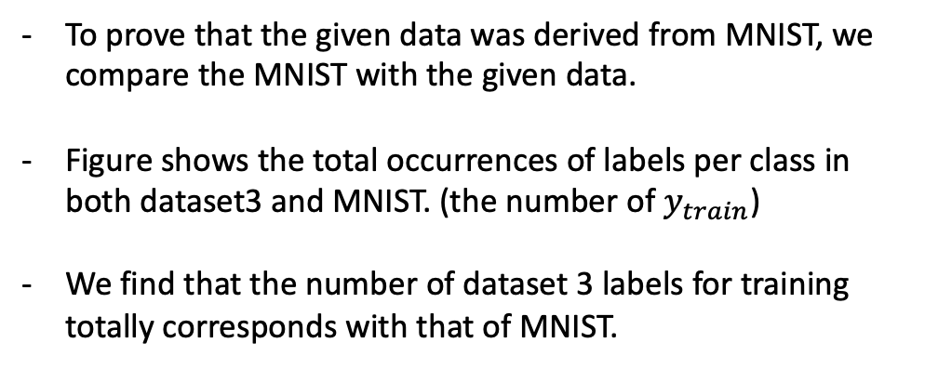
Where is it from?
Dataset 3 vs MNIST
23

Slide 24
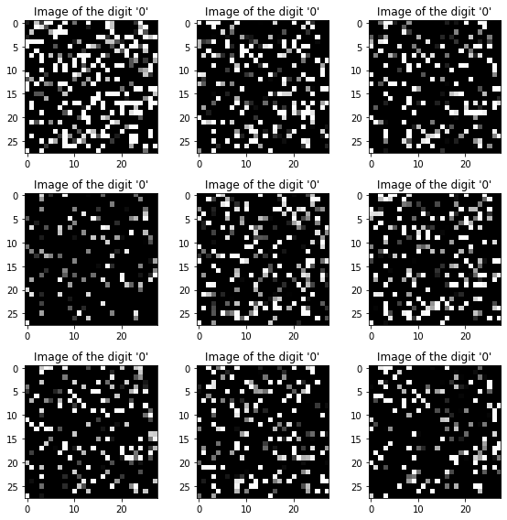
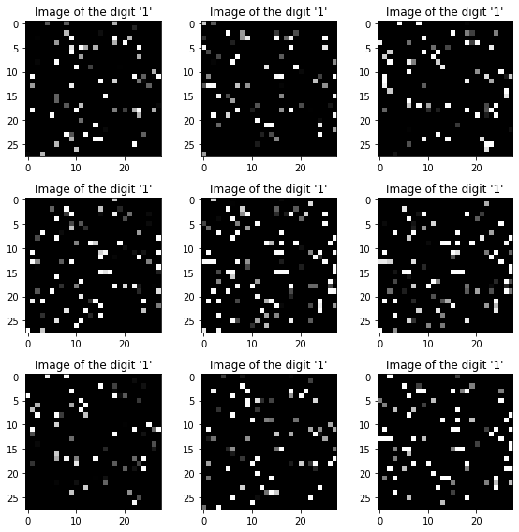
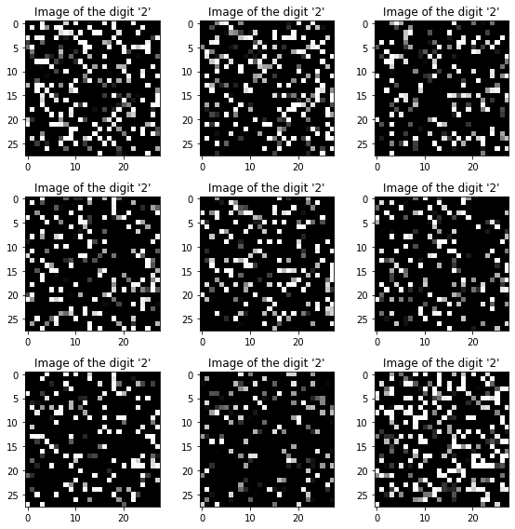
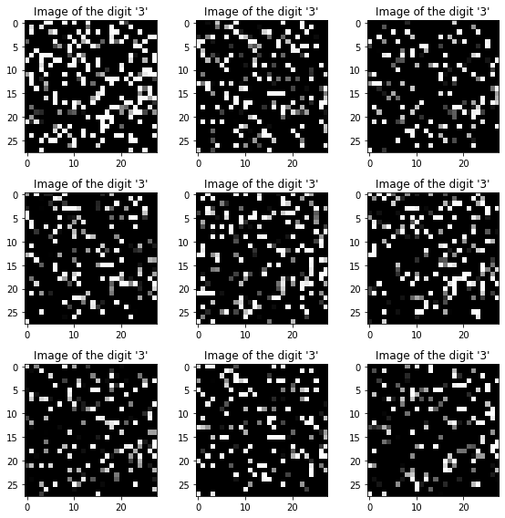
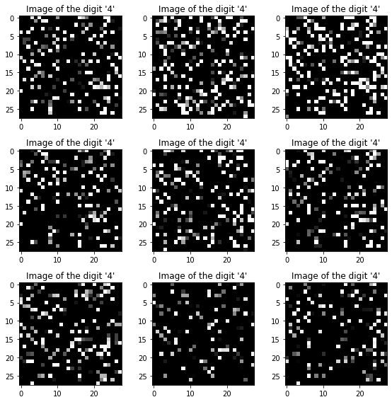
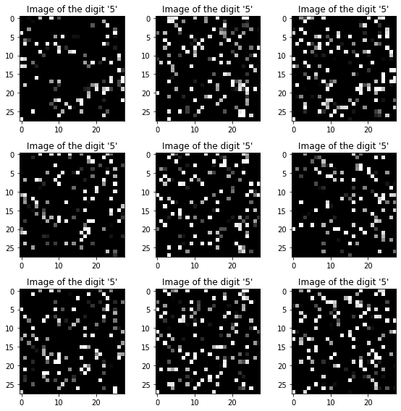
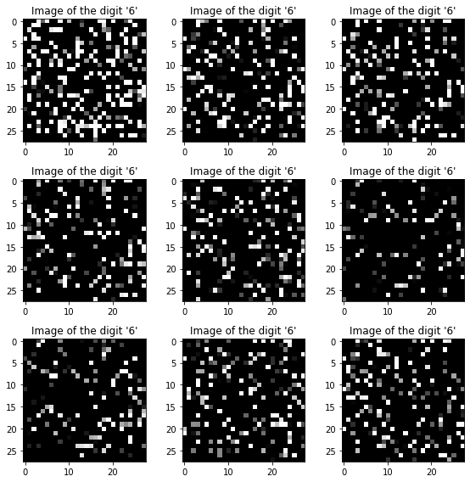
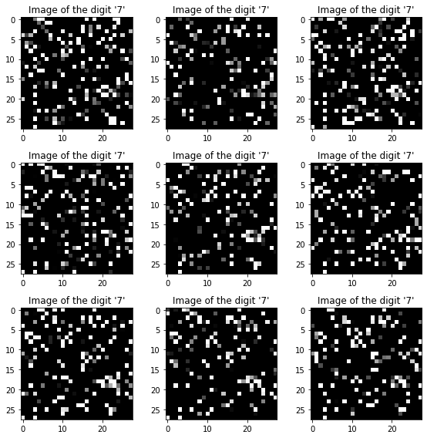
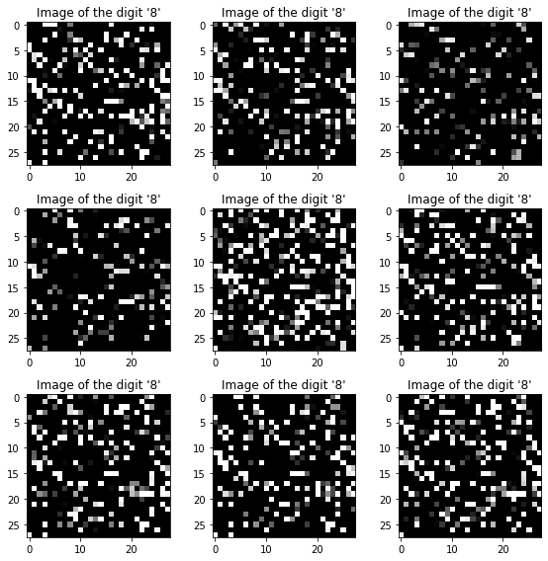
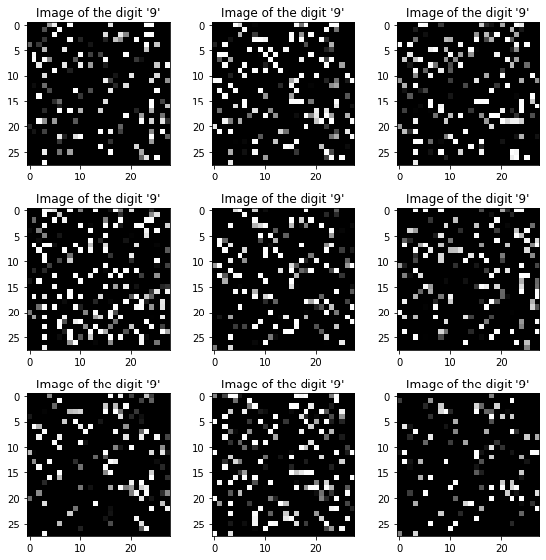
Dataset 3
Our assumption is that dataset 3 was transformed by permutation invariance on MNIST, which is a different random permutation of the input pixels.
0
1
2
3
4
5
6
7
8
9
24

Slide 25
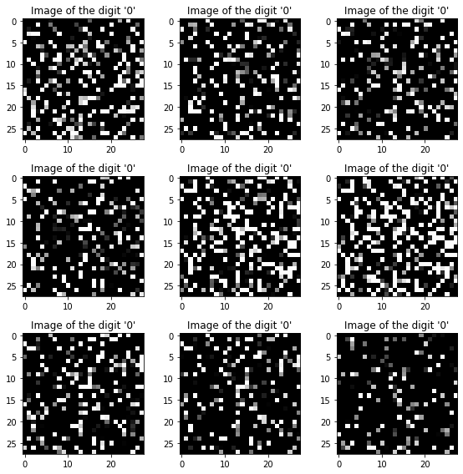
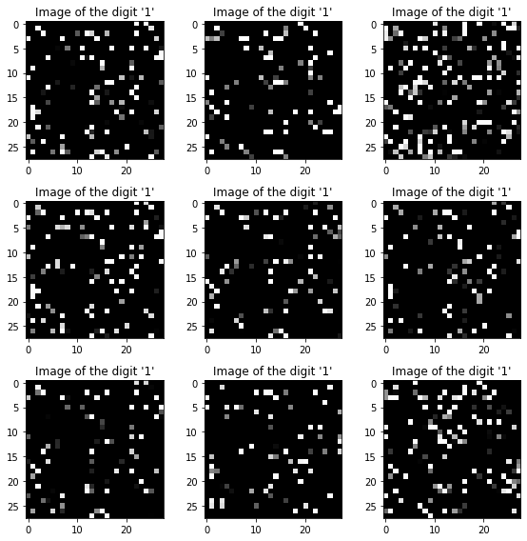
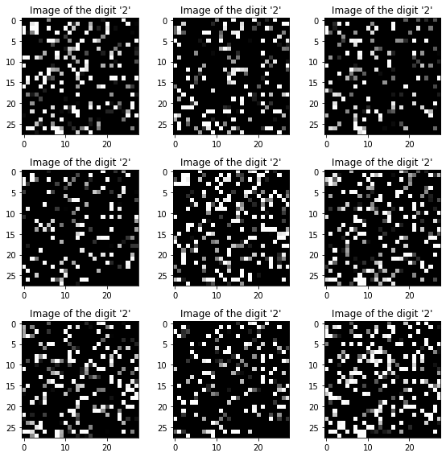
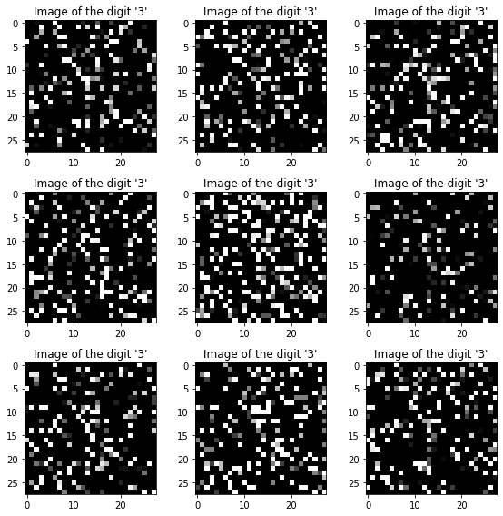
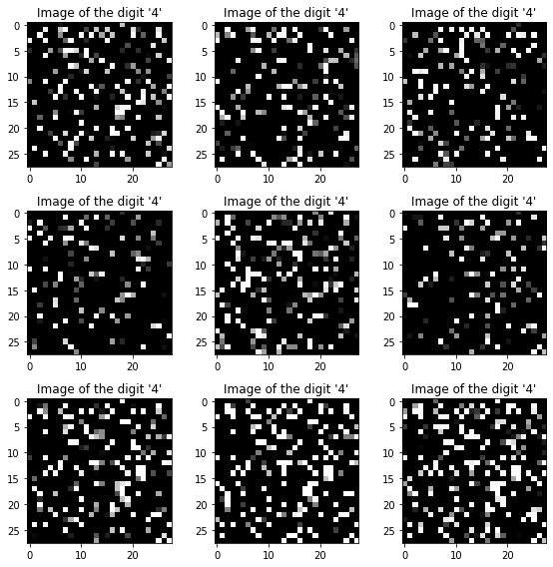
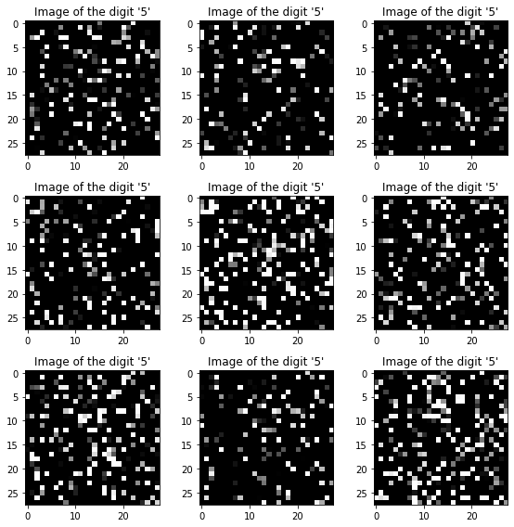
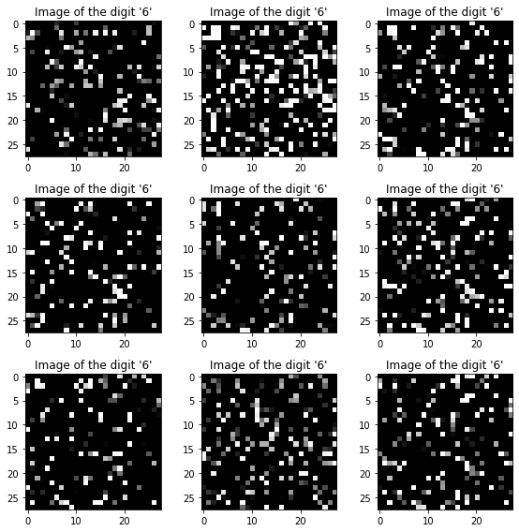
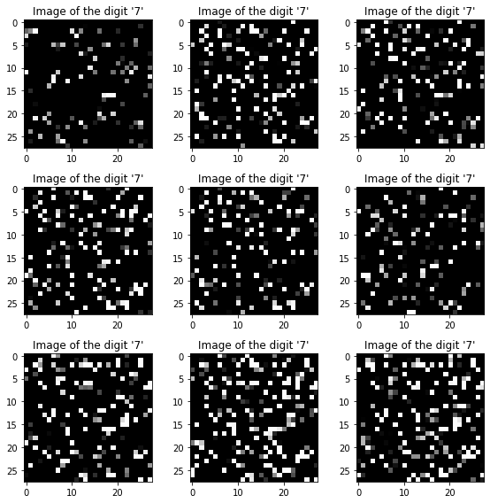
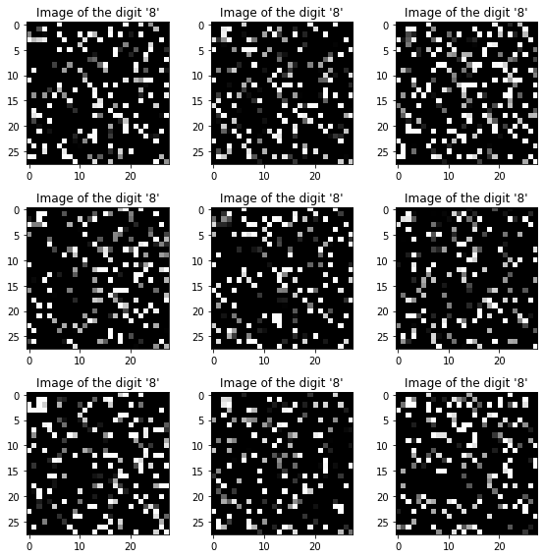
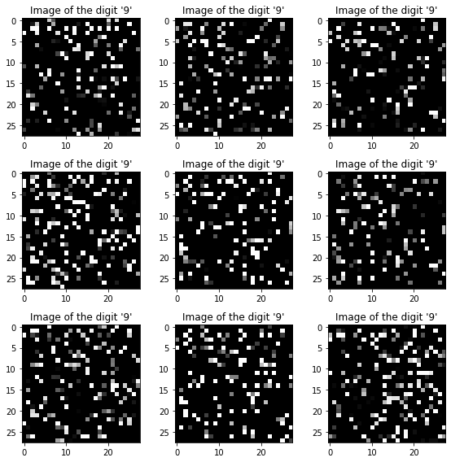
Permuted MNIST
To achieve that assumption, we try to convert MNIST into Permuted MNIST under permutation invariance method.
0
1
2
3
4
5
6
7
8
9
25

Slide 26

Model Architecture & Dataset
There is no reason why to use CNN because the dataset has rarely ‘spatial information’.
We use Fully Connected Neural Network for classification.
For better performance, we augmented the original dataset 3
under permutation invariance.
train: 48,000 🡪 192,000
valid: 12,000 🡪 48,000
test: 60,000 🡪 60,000
Adam optimizer (B1 = 0.9 & B2 = 0.999)
Learning rate: 0.001
Epoch / Batch_size: 100 / 128
26

Slide 27

Result
Accuracy 98.37
27

Slide 28
Dataset 4

Slide 29


Assumption
Structured, or Unstructured That is the question.
Text data
29

Slide 30


Assumption
Structured, or Unstructured That is the question.
Image data
30

Slide 31

Assumption
Structured, or Unstructured That is the question.
Time series
31

Slide 32

Assumption
Structured, or Unstructured That is the question.
Tabular data
First five rows of train and test data
32

Slide 33

Assumption
Structured, or Unstructured That is the question.
Tabular data
33

Slide 34

Modeling
Look before you build your model
Class label imbalance?
34

Slide 35

Modeling
Look before you build your model
Highly Correlated Features?
Orange dots represent “abs(corr)>= 0.3”
35

Slide 36

Modeling
Look before you build your model
Extreme Outlier?
36

Slide 37

Modeling
Look before you build your model
Missing values?
37

Slide 38


Modeling
Look before you build your model
Pipeline !
38

Slide 39


Result
Don't count your chickens before they hatch
LDA to QDA
LDA & QDA based ensemble model
39

Slide 40


Result
Don't count your chickens before they hatch
Flexible Decision Boundary
40

Slide 41


Result
Don't count your chickens before they hatch
Bang! Bullseye!
41

Slide 42
Dataset 5

Slide 43

Data Description
Data shape
Label Ratio
43

Slide 44


What is this data?
44

Slide 45
What is this data?
45

Slide 46

Image?
46

Slide 47

Image?
47

Slide 48
Train with a well pre-trained model
Class 1
Class 2
Class 3
Class 4
Class 5
Input image
Pretrained model
Replaced Layer
48

Slide 49

EfficientNet
49
Tan, Mingxing, and Quoc Le. "Efficientnet: Rethinking model scaling for convolutional neural networks." International conference on machine learning. PMLR, 2019.

Slide 50

Scale the image
10 X 10 🡪 32 X 32
INTER_NEAREST – a nearest neighbor interpolation
INTER_LINEAR – a bilinear interpolation
INTER_AREA – resampling using pixel area relation
INTER_CUBIC – a bicubic interpolation over 4 X 4 neighborhood
INTER_LANCZOS4 – a Lanczos interpolation over 8 X 8 pixel neighborhood
50

Slide 51


Summary
10 X 10 image
32 X 32 image
Resize using Interpolation
EfficientNet
51

Slide 52

Result
EfficientNetB1
Batch size – 32
Learning rate – 0.0001
Optimizer – Adam
Interpolation – INTER_LINEAR
52

